Slide 1
Vision Guide
An aid for visually impaired

Slide 2
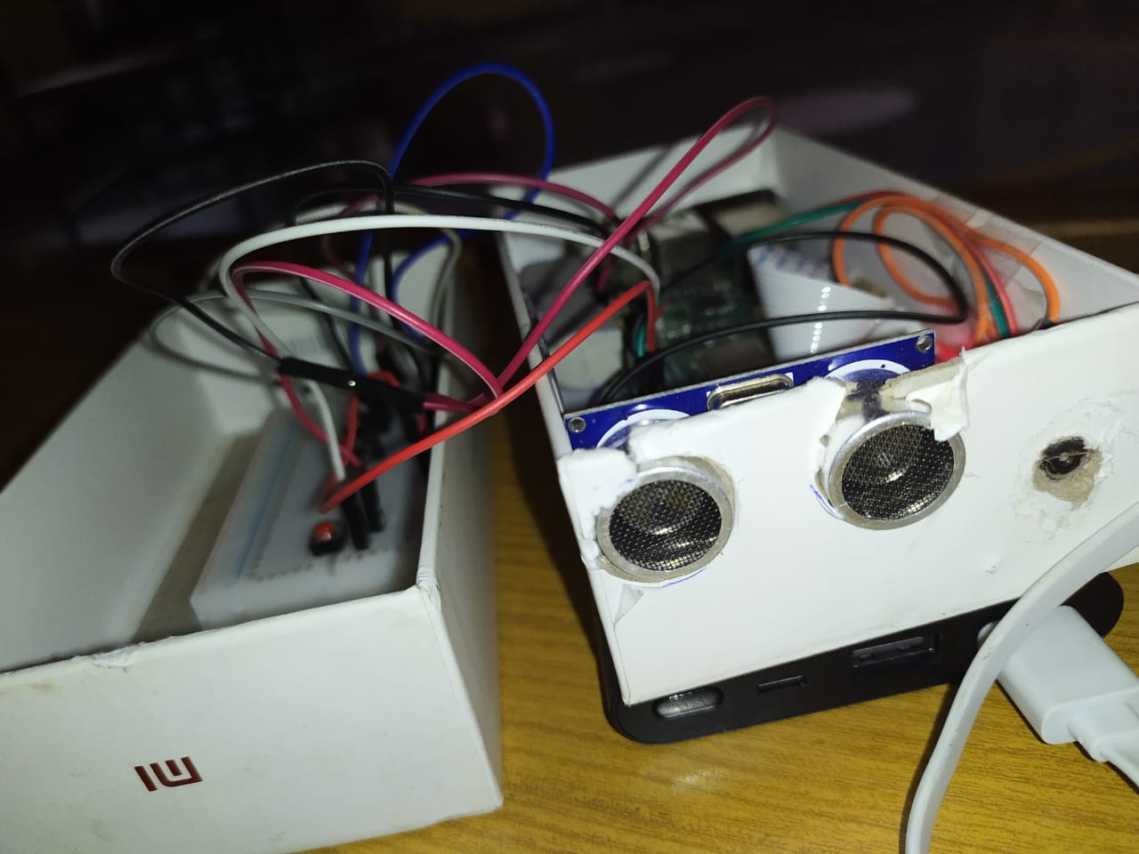
Brief Introduction:
The main objective of our project is to ease the life of visually impaired by making a system which is basically a combination of IOT(Internet of Things) and Machine Learning.This can be achieved by implementing 'Object detection', 'Optical Character Recognition' and 'Currency detection' that can be helpful in day to day life of a blind.

Slide 3
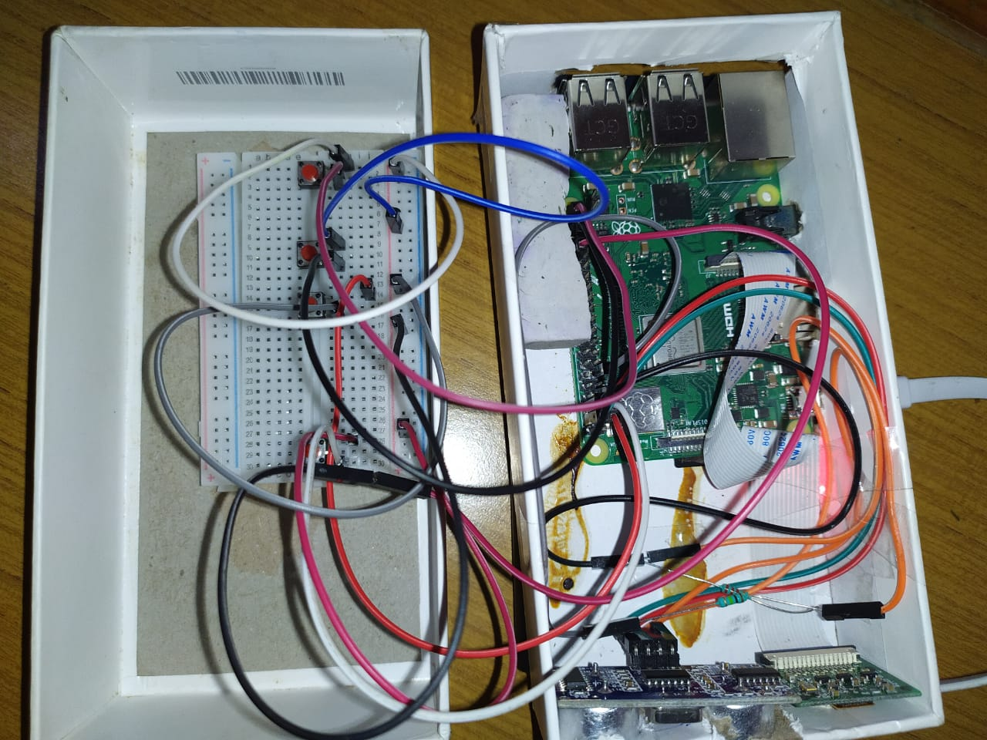
Requirements:
Tensorflow >=1.12.0
OpenCv
Python
Matplotlib
Numpy
pyTesseract
Raspberry pi
Ultrasonic Sensors
Camera
Jumper Wires
Breadboard, Buttons

Slide 4
Object Detection
Object Detection is the process of finding real-world object in still images or Videos. It allows for the recognition, localization, and detection of multiple objects within an image which provides us with a much better understanding of an image as a whole.
Application:
Facial Recognition
People Counting
Self Driving Cars

Slide 5
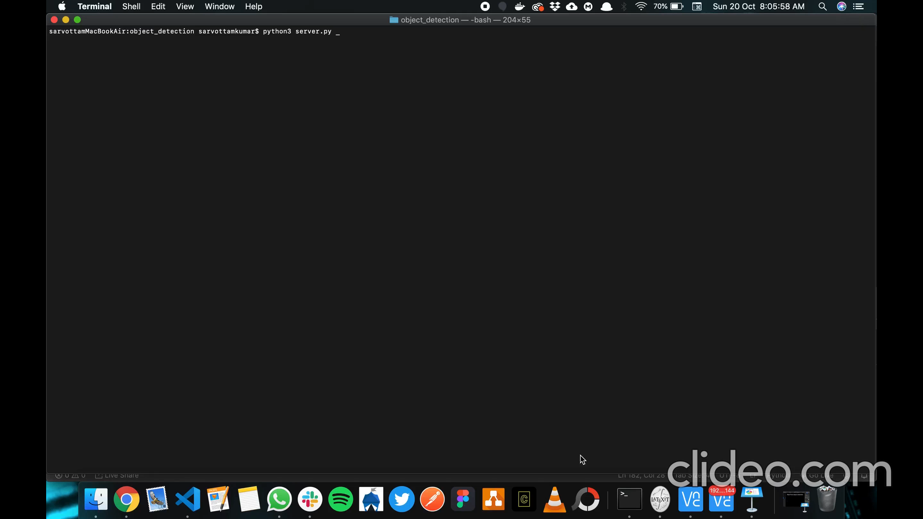

Slide 6
Optical Character Recognition
This is a classic machine learning problem that includes identifying the text from the image.To implement it we have make use of pyTesseract which accepts the inputs from the camera sensor of Raspberry Pi and then identify the text from that image.We have created a text recognition file which uses openCv library for text identification.

Slide 7
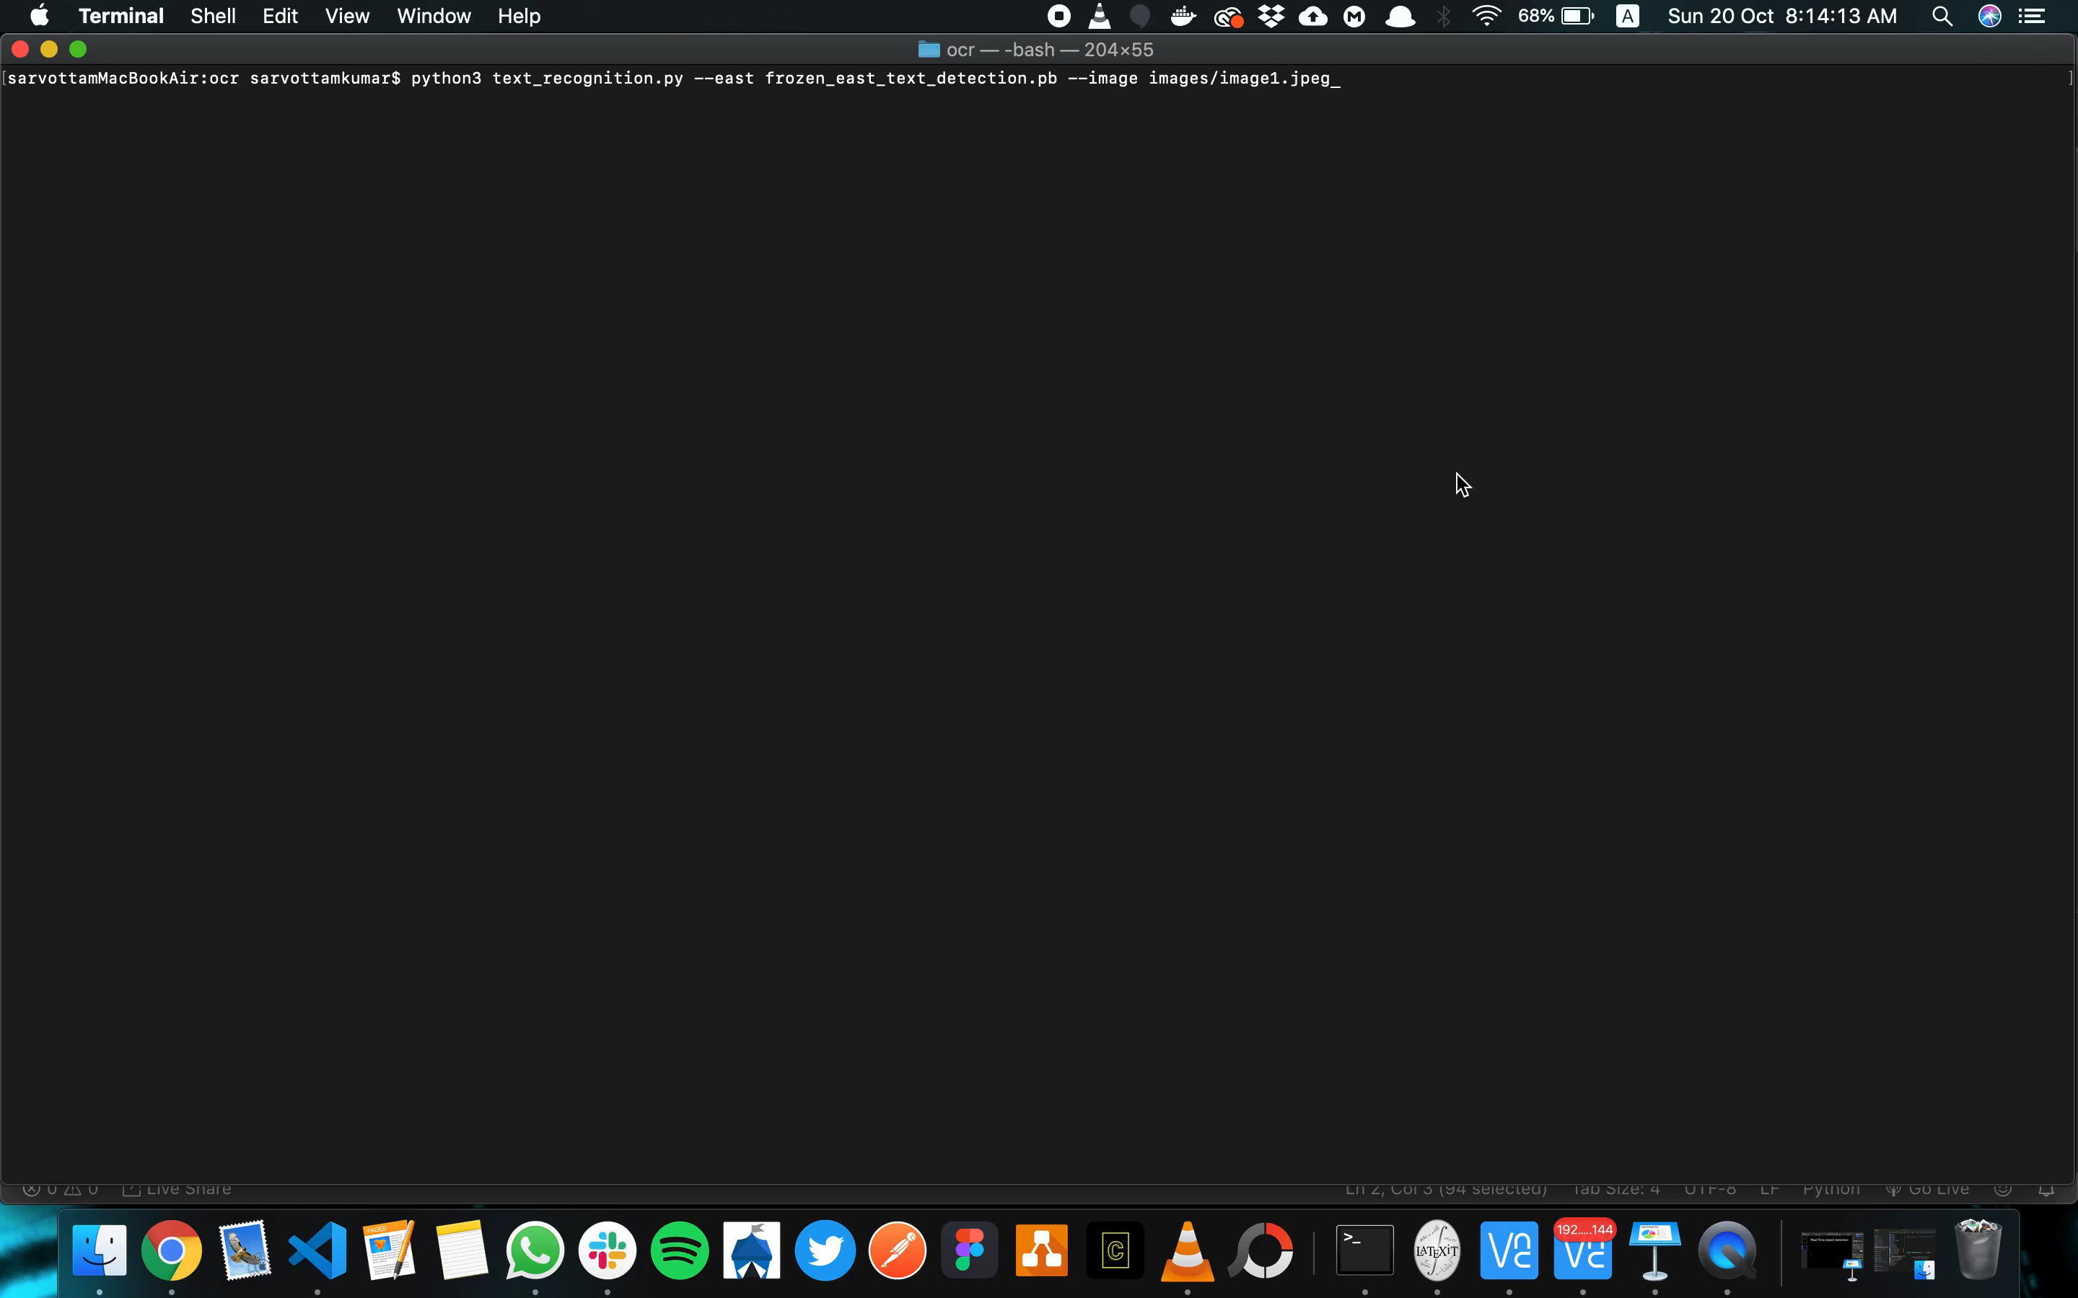

Slide 8
Currency Recognition
To detect currency we have used the OpenCv library in python.First we took some sample image of the Currency notes as our training set. Then we have trained our model for these images based on the label that the image belong to the particular currency.The code structure is like mwe have a util module which contain various function that we will require like display,convert the image etc files. The main code is in the currency detection file which consist of training our model on the sample image

Slide 9
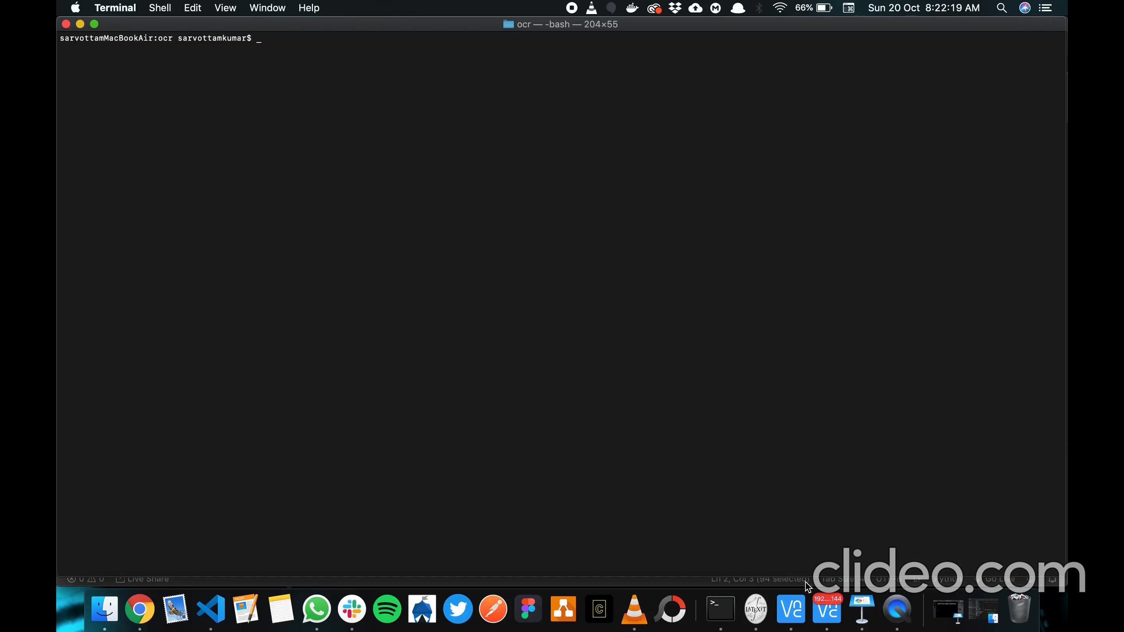

Slide 10
Thank You

